Slide 1
Reduce: Gender Comic
Harley French
Sustainable Graphic Design

Slide 2
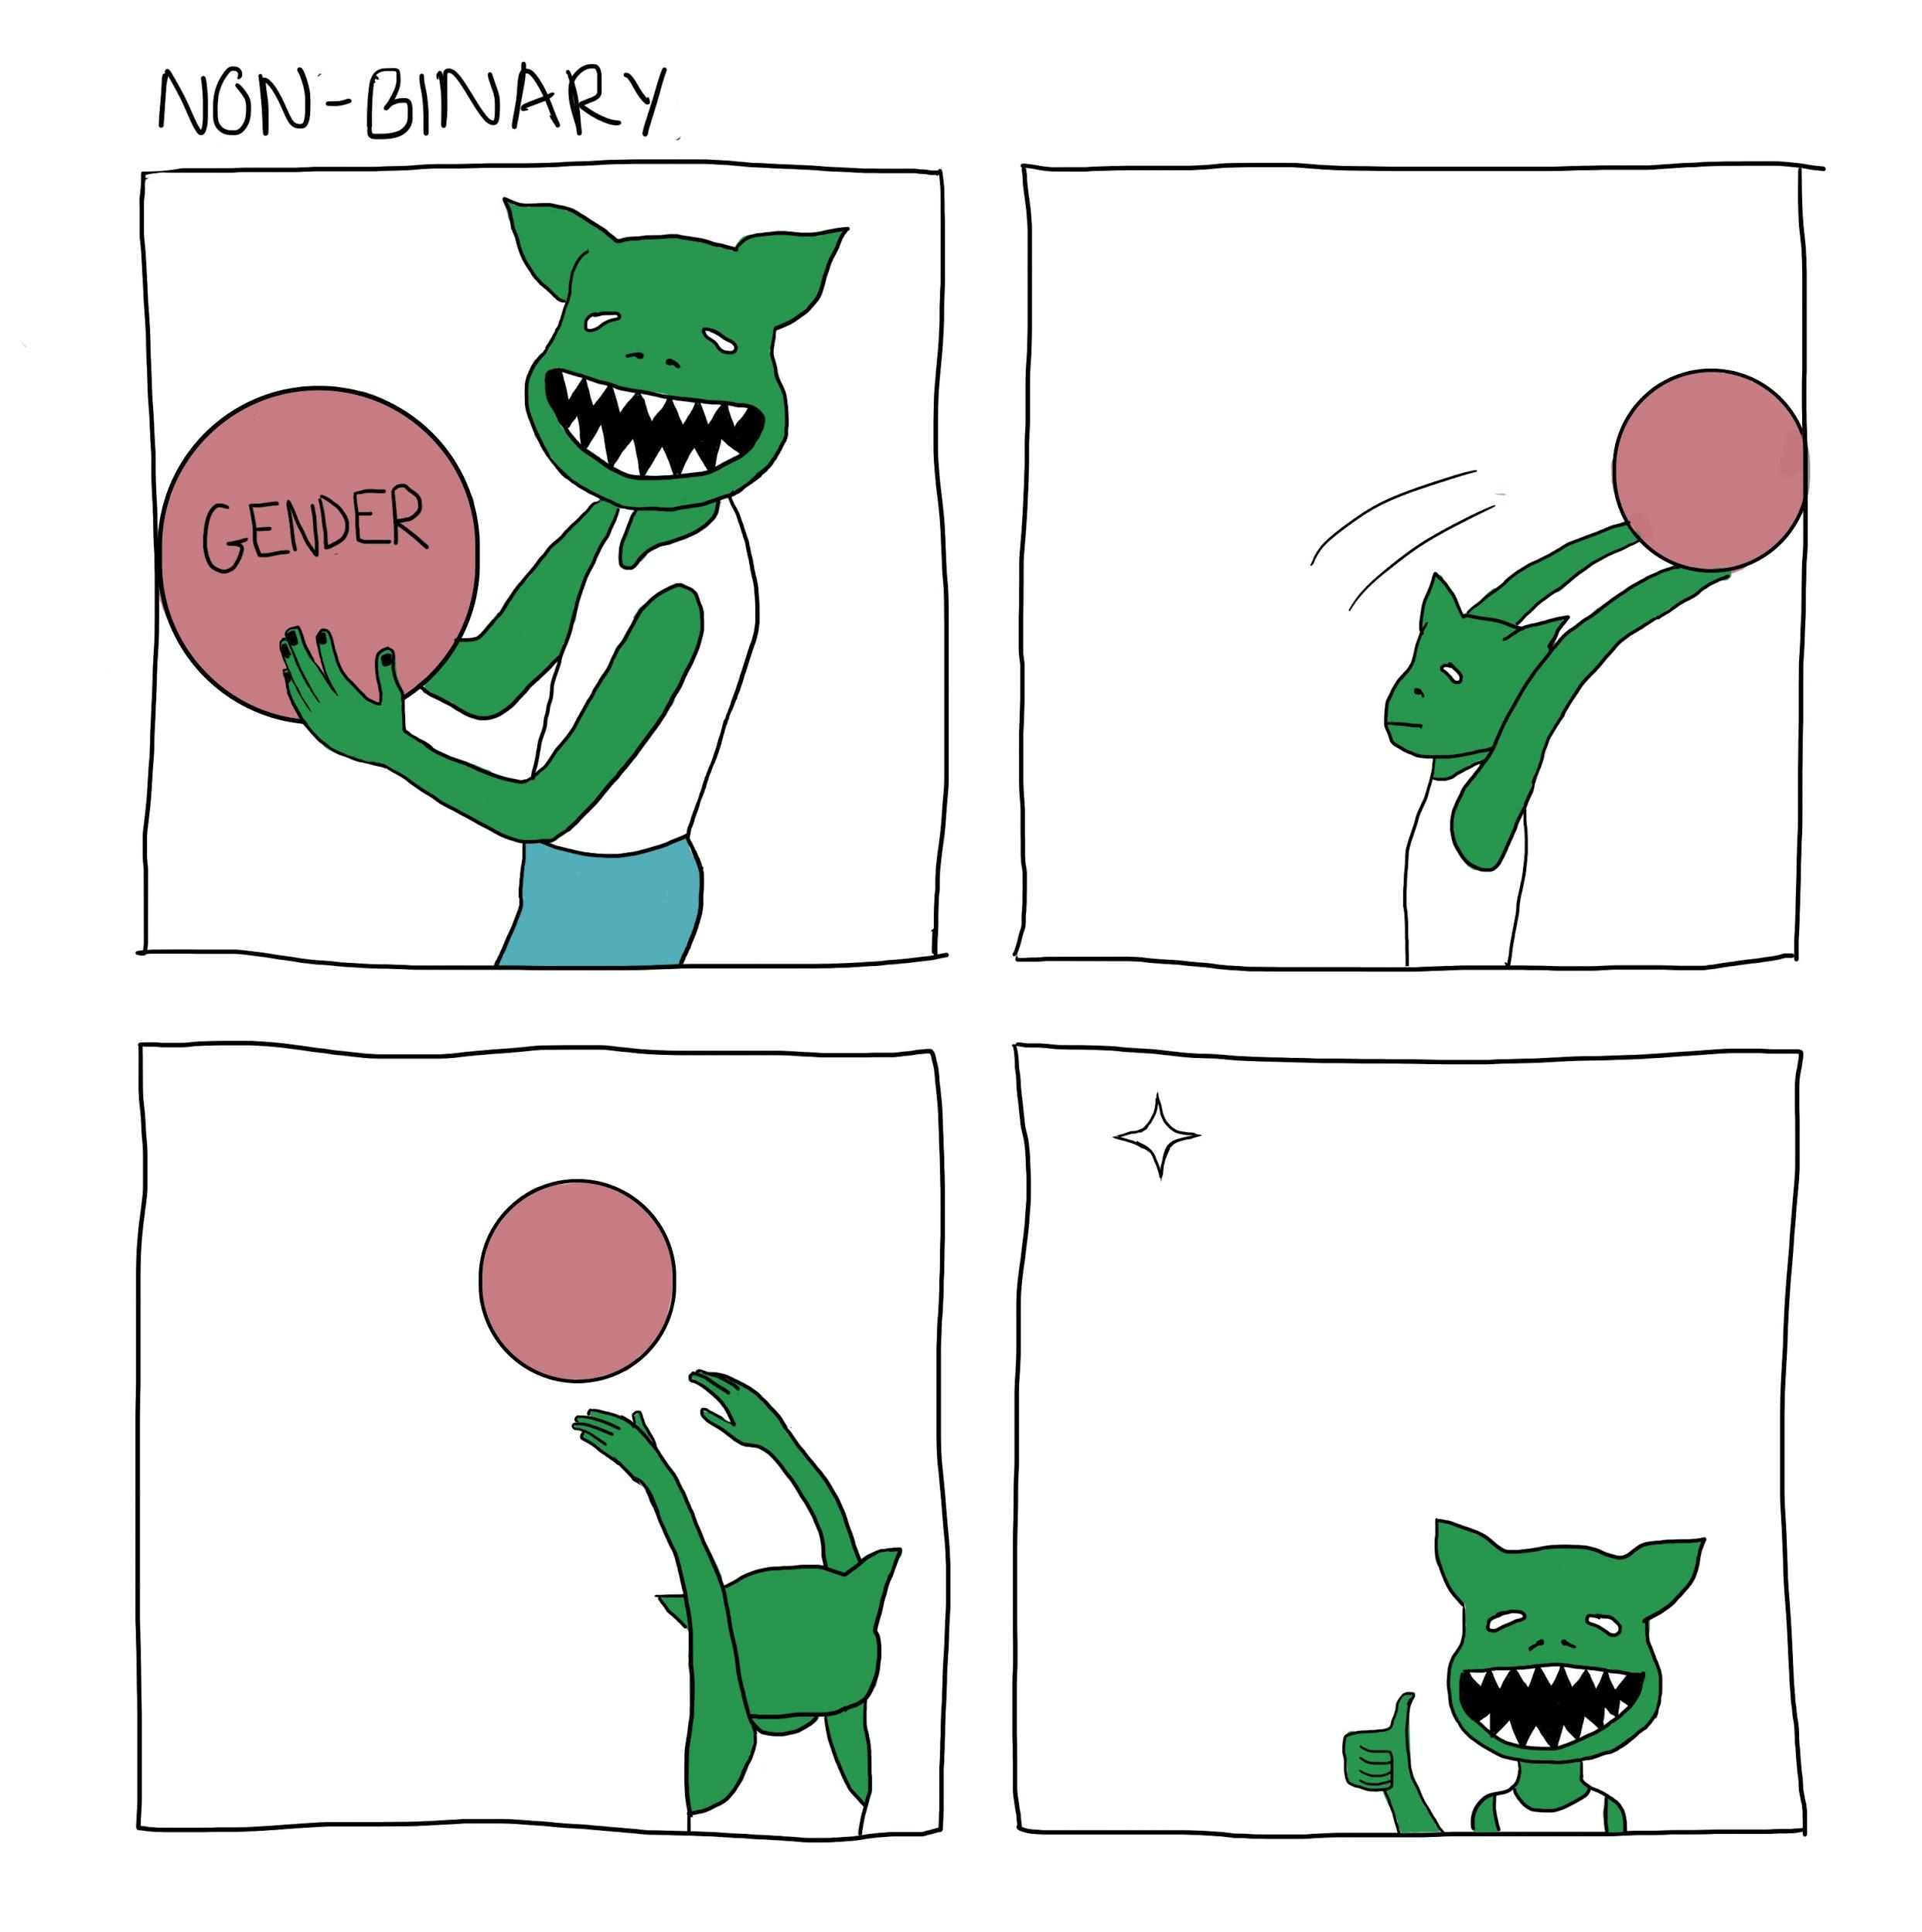
Original
Image

Slide 3
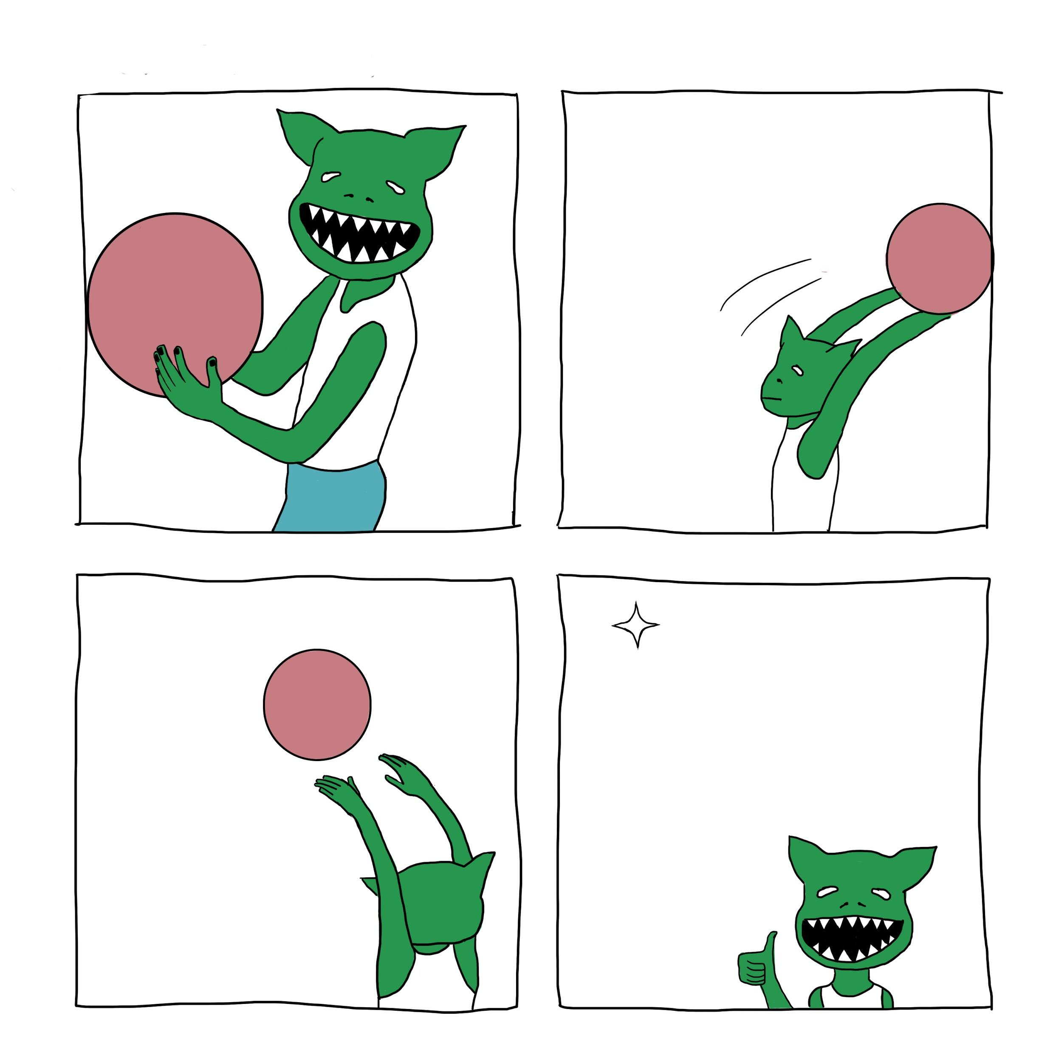
No Text
(I tweeted this comic as a meme format, when I had just made it!)

Slide 4
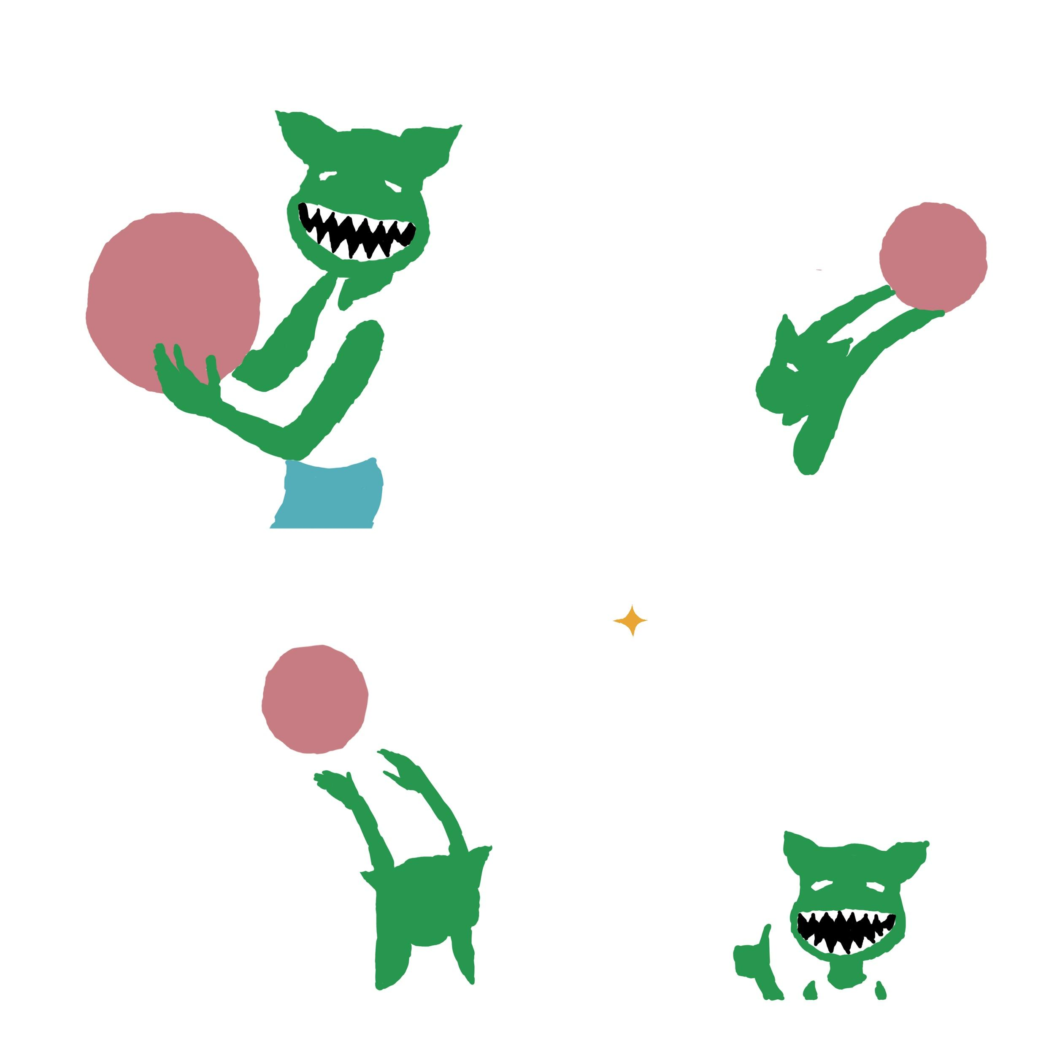
No Text
or Lines
(All Color)

Slide 5
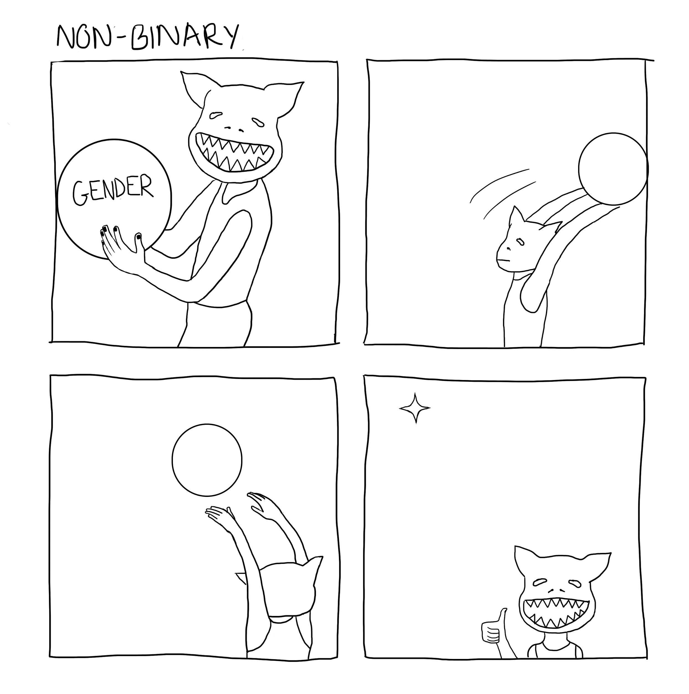
No Color (All Lines)

Slide 6
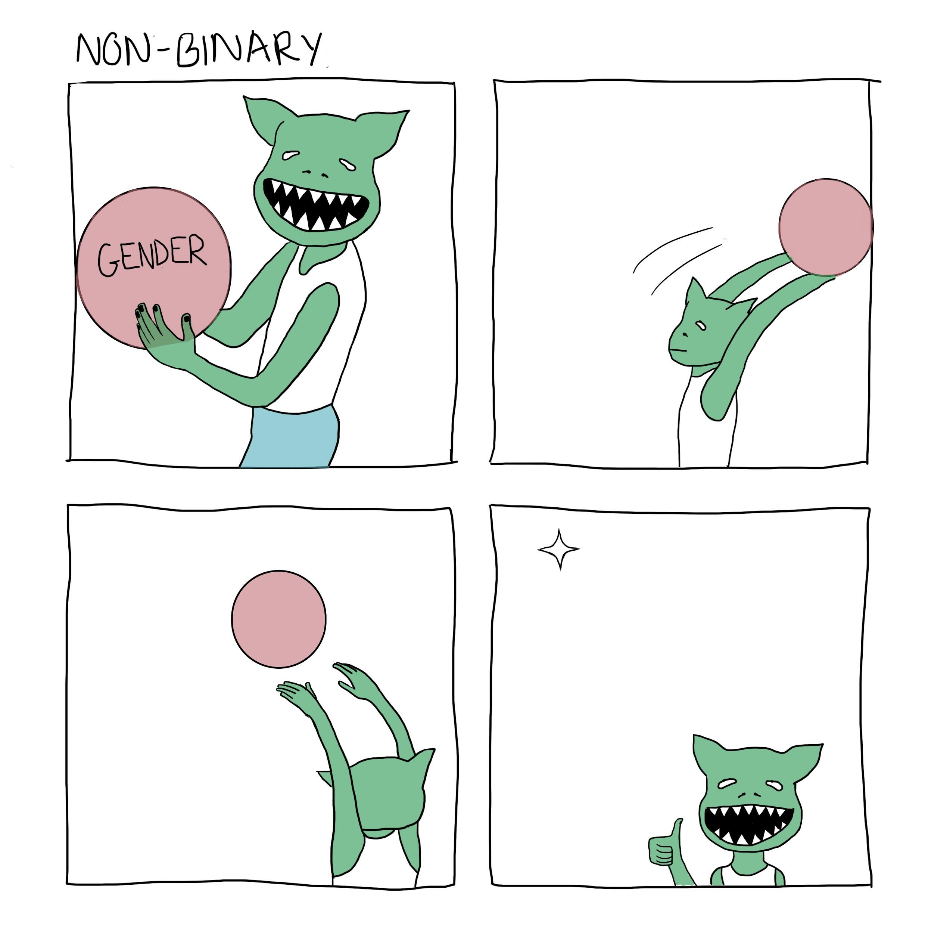
Reduced Opacity

Slide 7
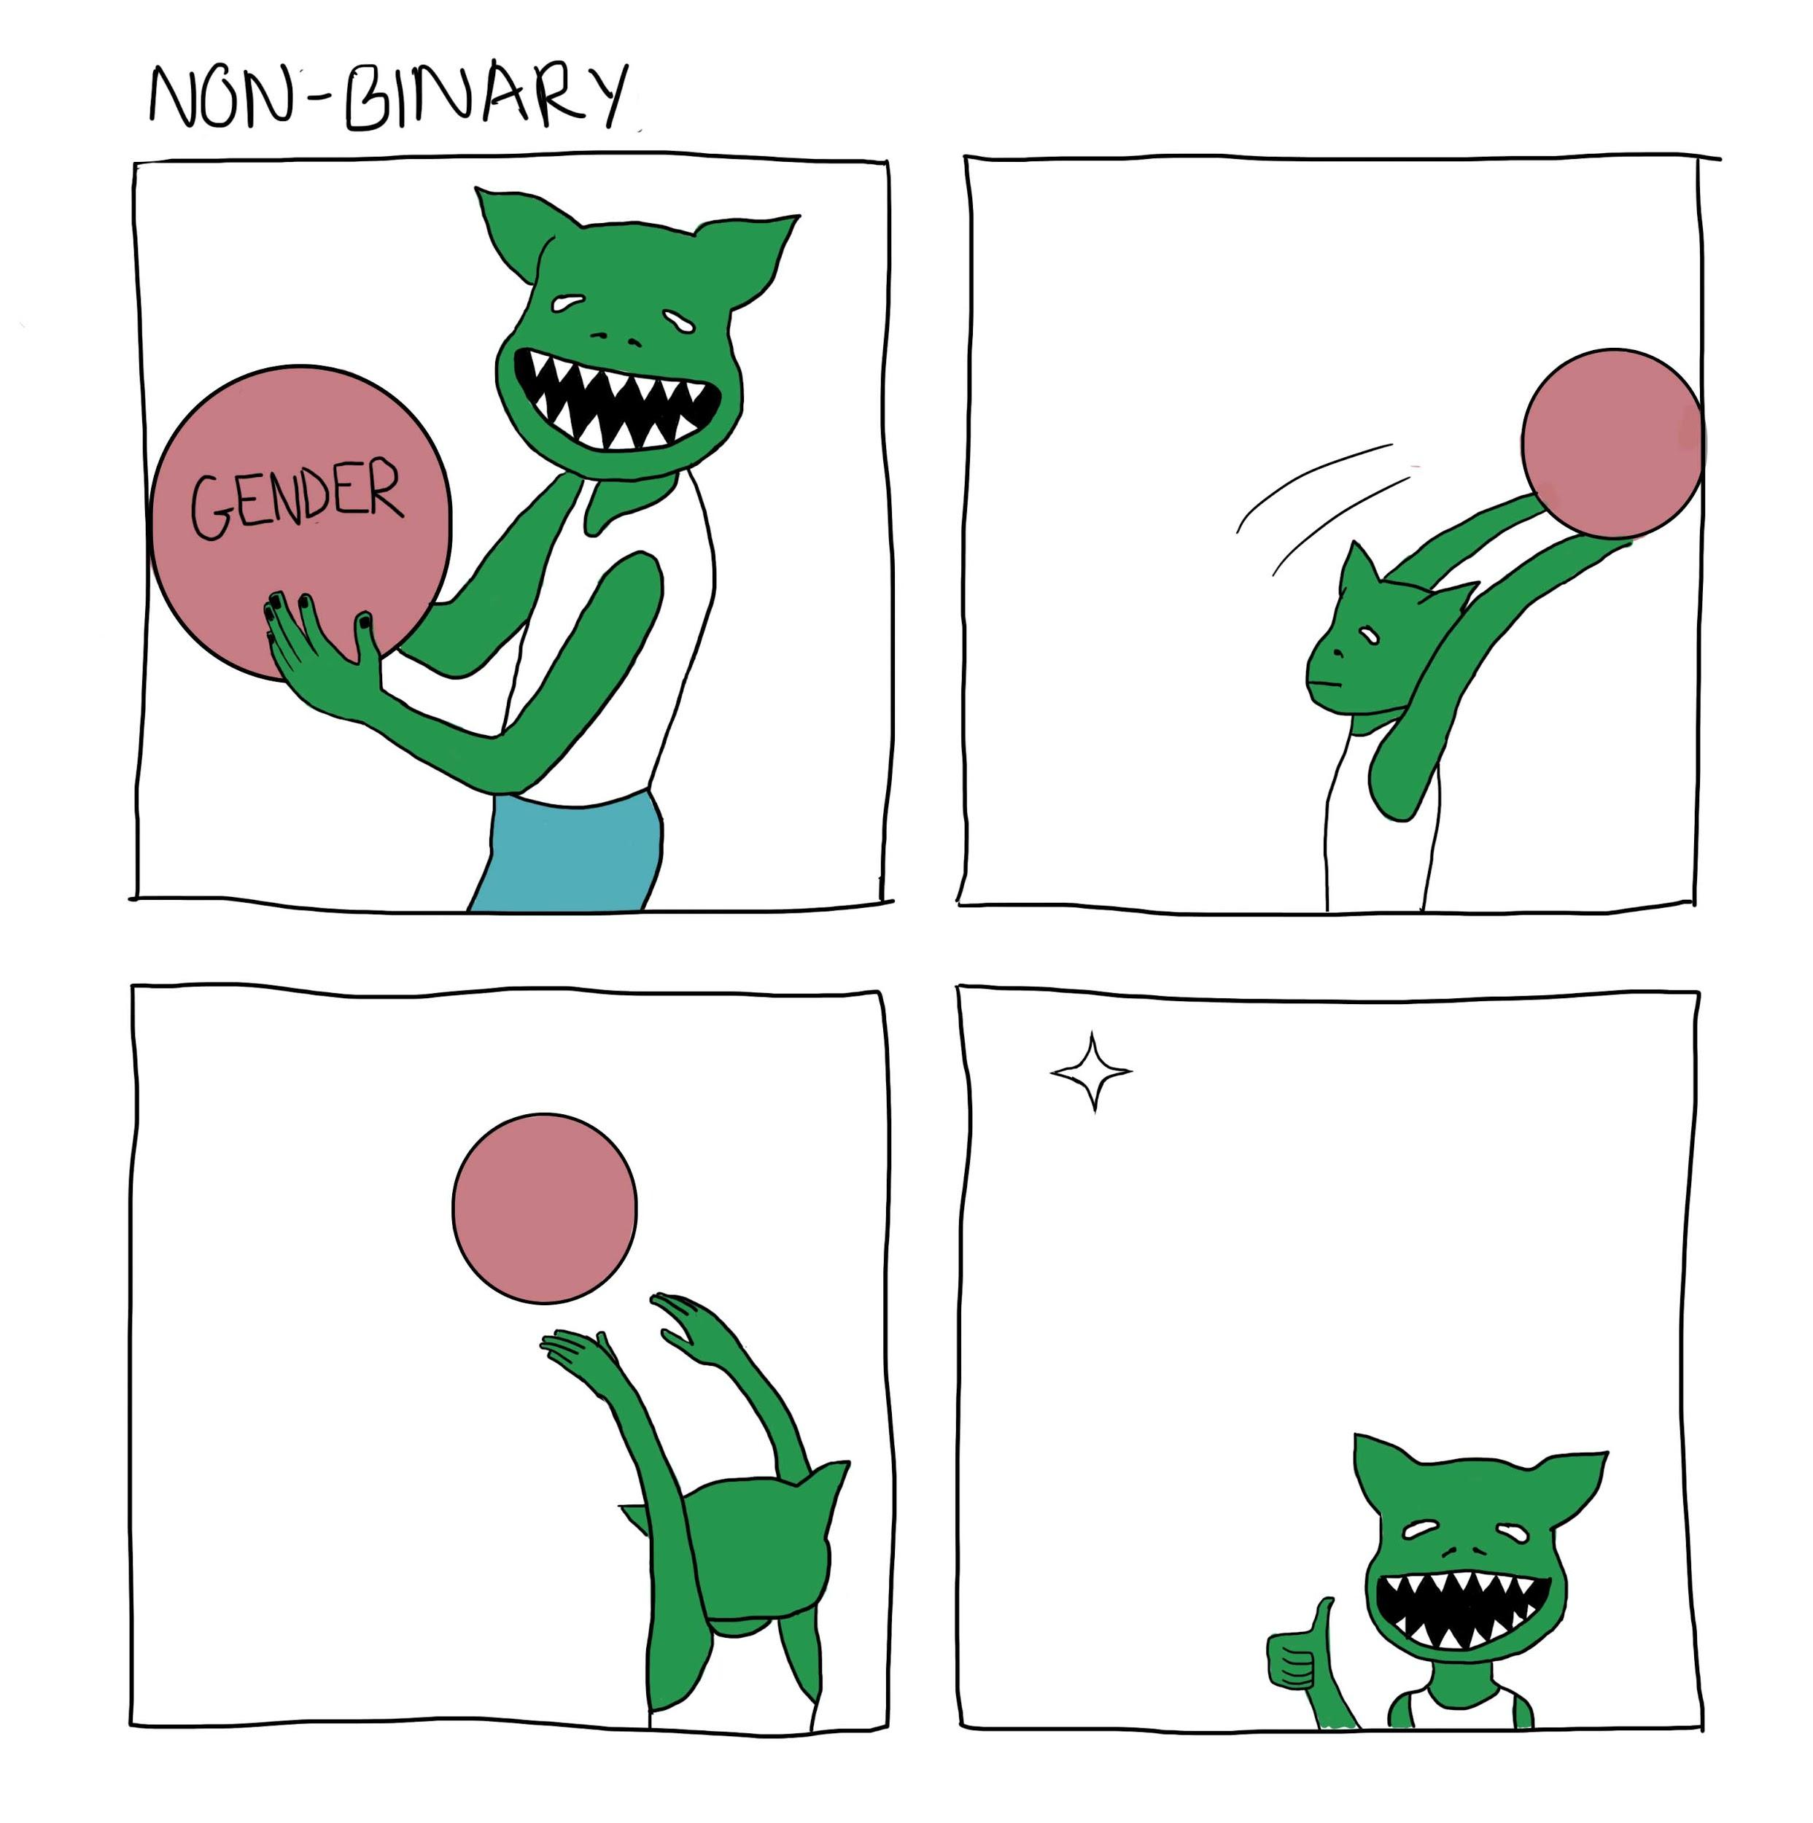
Reduced File Size
(It’s amazing how hard it is to see a difference)

Slide 8
Final Thoughts
Not a very successful project-choice
I have very few digital projects
Still important/interesting to consider in the future

